Slide 1
Student Life and Well-being
Hadar Giat & Daniel sant‘ Benvenisty

Slide 3
Student Life and Well-being
Special Jewish Studies Courses for International Students

Slide 4
Student Life and Well-being
Hebrew Courses for International Students

Slide 5
Student Life and Well-being
Social Activities

Slide 6
Student Life and Well-being
Public Transportation and Life in Israel

Slide 7
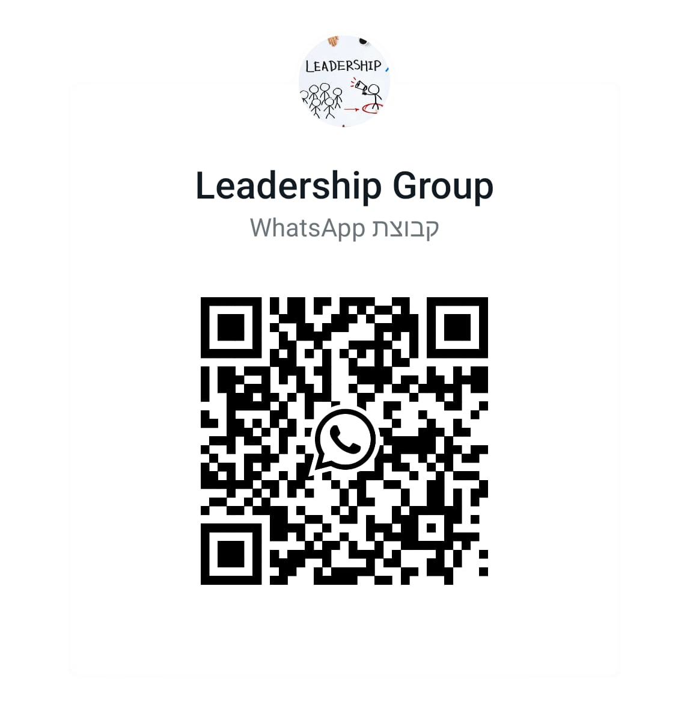
Student Life and Well-being
Leadership Group for International Students

Slide 8
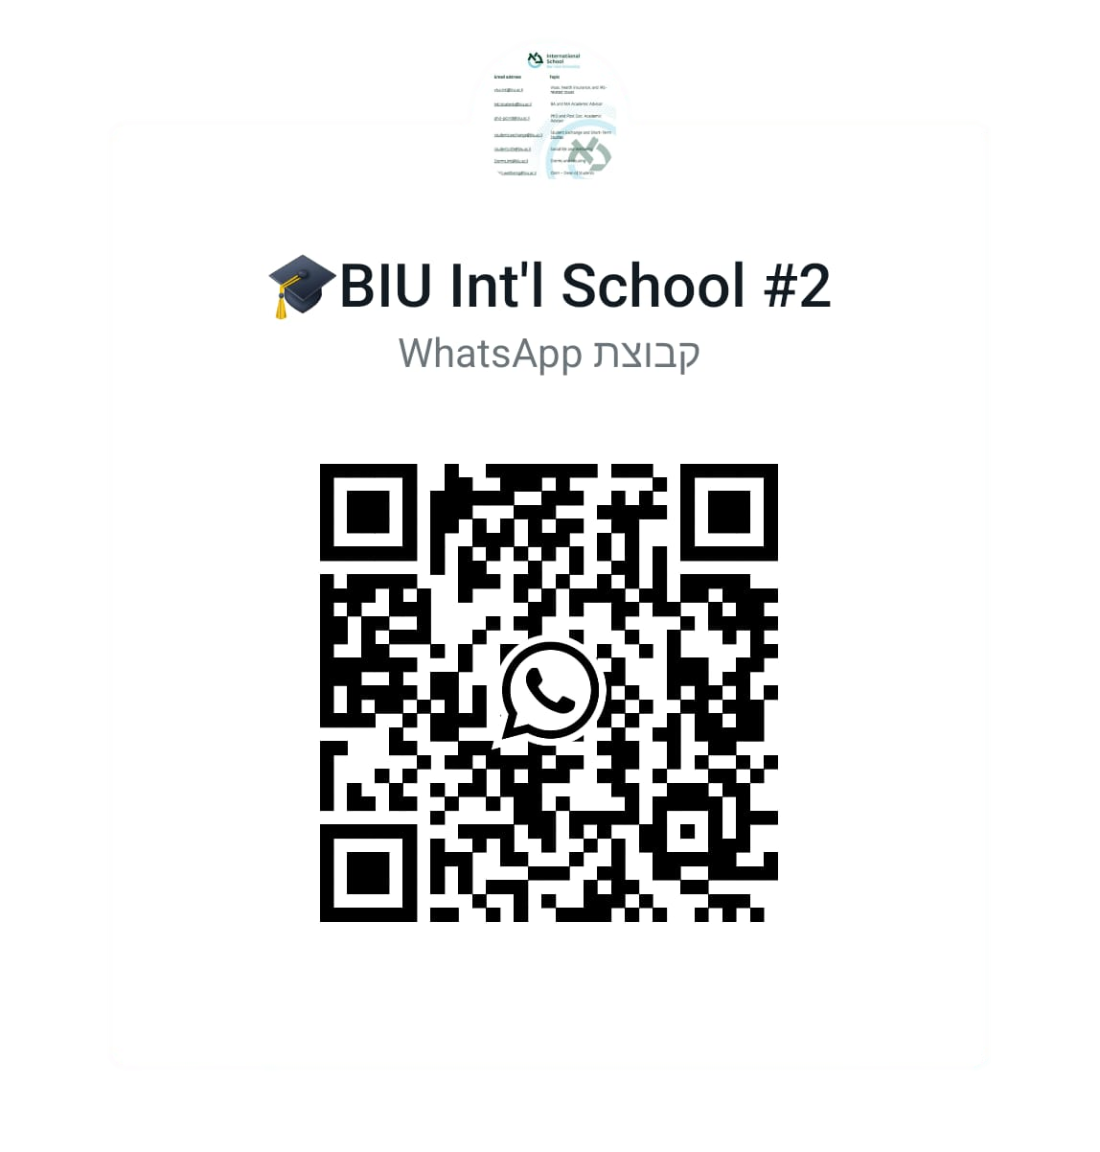
Student Life and Well-being
One-on-One Meeting with the Director of Student Life and Well-being
Hadar Giat
Director of Student Affairs & Well-being
Mobile +972.54.4932696
Office +972.3.7384742
Email students.life@biu.ac.il

Slide 9
Thank you! Hope you enjoy your stay

